Slide 1
Monster Hunter Builder
By Jason Haroldson

Slide 2
Project Idea/Specifications/Requirements
Focus: Making a tool to help create/store build ideas for Monster Hunter: World. While building the builds is the main control. I want to be able to also track what abilities, accessories, and material costs to give the players a general checklist of what they need to farm for.
Goals: Interactive and easy to understand user interface, while also being easy to navigate.
Requirements: Work on commonly used browser (chrome, firefox, edge) and work on android devices

Slide 3
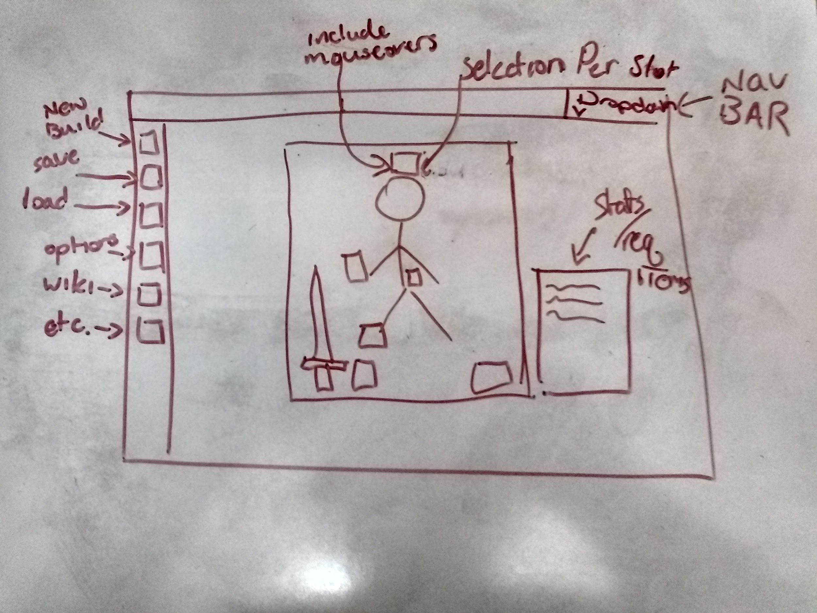
Potential Design Concept

Slide 4
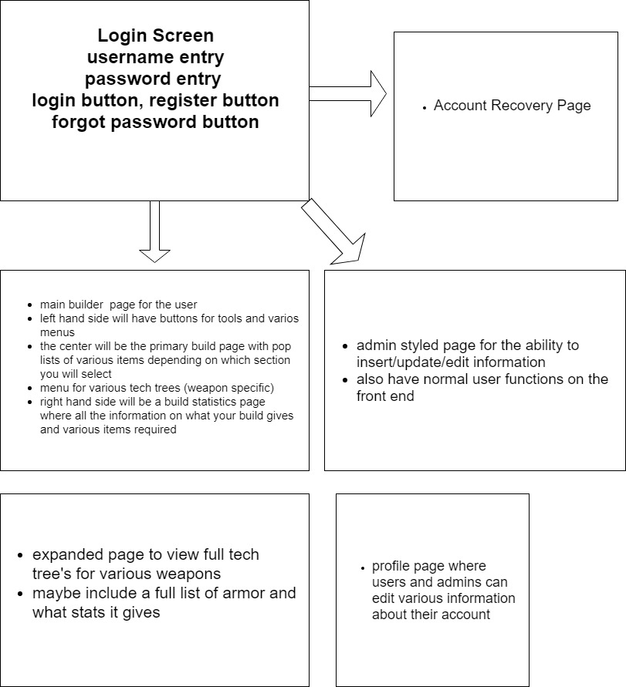
More Diagrams

Slide 5
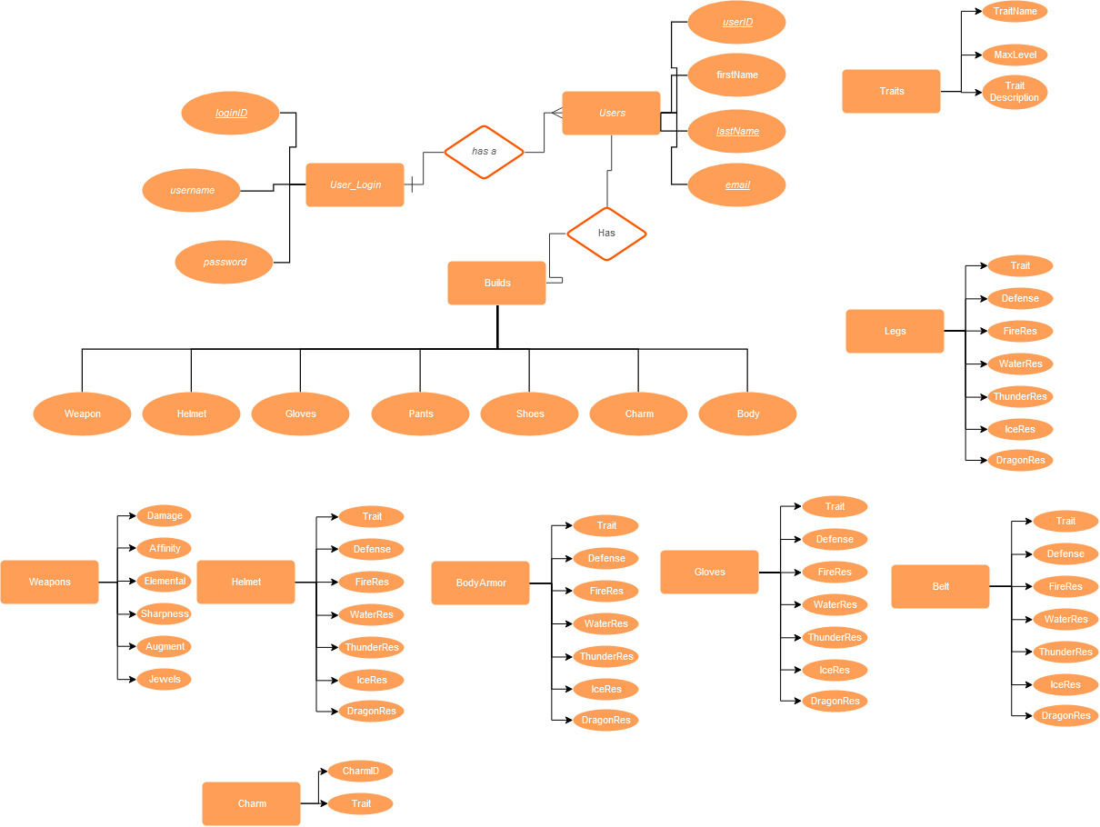
More Diagrams

Slide 6
Functional Requirements
High:
Database to keep track of all the equipment in the game, all of the traits and other attributes associated with the equipment including decorations/jewels
The main application will take normal user logins and allow registration
users will be able to create and save any builds.
users will be able to view the tech trees of various weapons and also search for specific weapons/armor/etc.
users will see a list of all statitics including all equipped traits
User Interface will be easy to navigate
users should be able to search through the database of items to create builds for that they can use for reference in monster hunter world
low:
be able to use the builds and get a resulting amount of materials list (list of materials needing to acquire to make the build)
also include normal inventory items (consumables) and an inventory build tracker
make the website modular enough to later introduce other monster hunter games.

Slide 7
Non-Functional Requirements
The Project should support at least Google Chrome, Firefox, and Microsoft Edge
The Project server using Sql Server and Sql Server Management studio
The Project should be able to be converted to work with mobile platforms

Slide 8
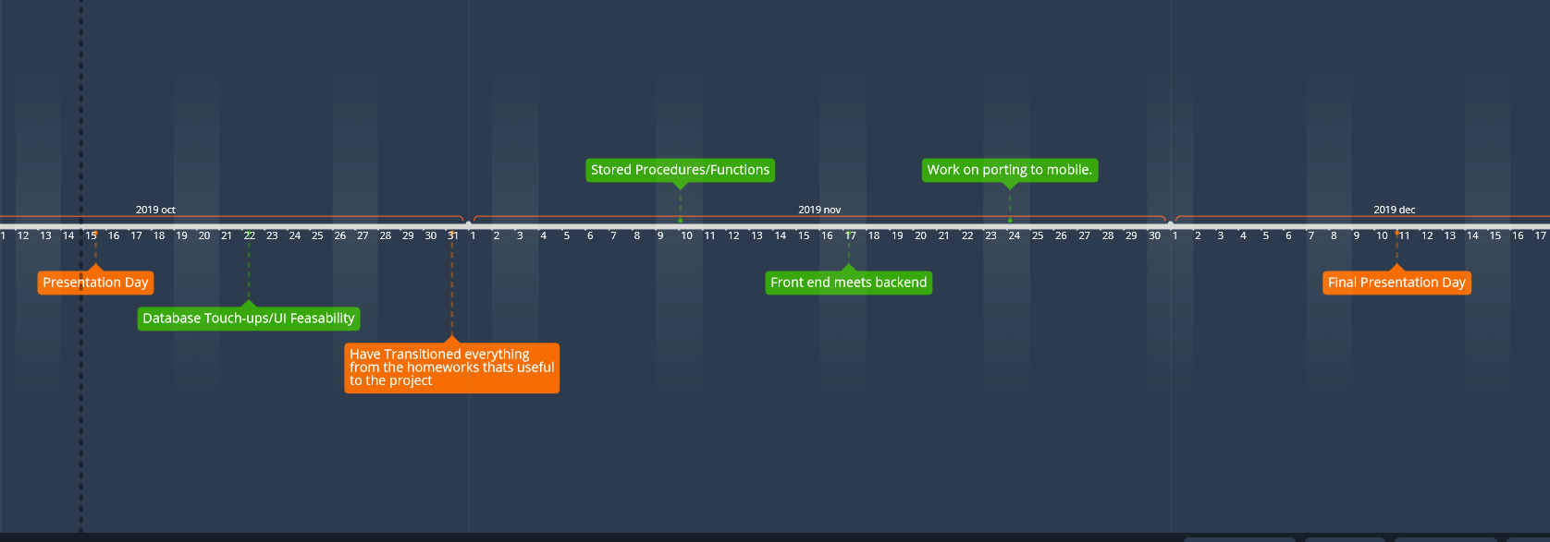
Timeline and Estimate
Estimate: I left the a larger gap in the end of my timeline just in case other stuff gets delayed. My estimated needed is about 140 hours

Slide 9
Questions?

